Slide 1
protein secondary structure prediction Using B-Lstm
Team. Protein
Yoon-Jae Chae
Ji-Beom Jung
Eun-Sun Kim
Eun-Joo Kim

Slide 2
Index
Motivation
Introduction
Protein structure
Classification process
Data Set
Input & Output
Pre-Processing
Model
Compare of each model
Word Embedding
Bidirectional LSTM
Time Distributed Dense
Activation Function
Hyper Parameter
Conclusion

Slide 3
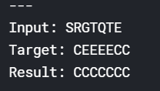
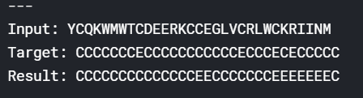
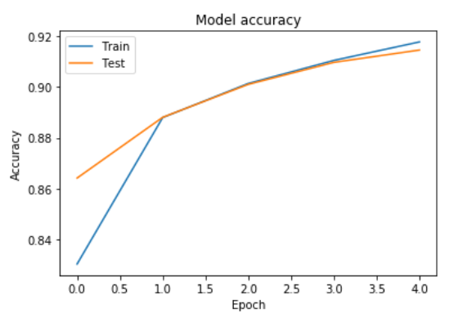
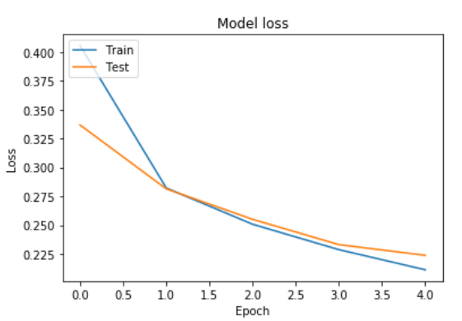
Motivation
Reference : https://www.kaggle.com/alfrandom/protein-secondary-structure#2018-06-06-pdb-intersect-pisces.csv

Slide 4
Introduction
Amino acid Sequence secondary structure
Amino acid
Sequence
secondary structure
Pattern recognition
Deep Learning
New Protein
구조예측
모델
helix, pleated sheet
RNN, GRU. B-LSTM

Slide 5
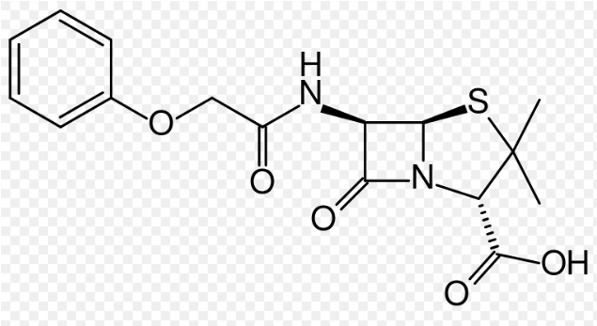
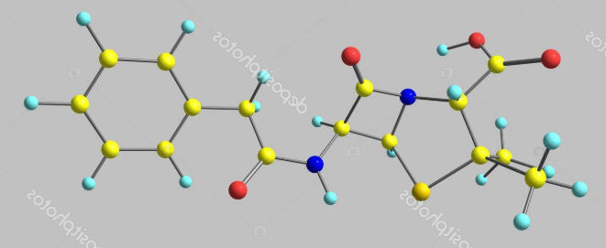
Introduction

Slide 6
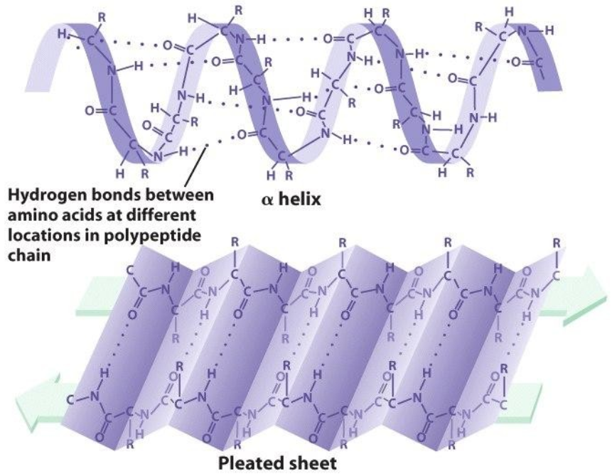
protein structure

Slide 7
Classification process
SST8
SST3
G
3-helix (310 helix)
H
α-helix
H
G
I
5 helix (π-helix)
H
E
X
C
I
X
S
bend
B
residue in isolated β-bridge
B
S
T
hydrogen bonded turn
E
extended strand,
participates in β ladder
T
E

Slide 8
Data Set
pdb_id | chain_code | seq | sst8 | sst3 | len | has_nonstd_aa
1TJG | P | ELDKWAS | CBCTTTC | CECCCCC | 7 | FALSE
1U8H | C | ALDKWAS | CBCTTCC | CECCCCC | 7 | FALSE
1U8I | C | ELDKWAN | CBCTTCC | CECCCCC | 7 | FALSE
2J9J | C | *SLN*I* | CCBBCBC | CCEECEC | 7 | TRUE
1U8L | C | DLDRWAS | CBCTTCC | CECCCCC | 7 | FALSE
2FIV | I | *AV*EA* | CCEEECC | CCEEECC | 7 | TRUE
1U8N | C | ELDKFAS | CBCTTCC | CECCCCC | 7 | FALSE
1Z56 | E | ******* | CEECCBC | CEECCEC | 7 | TRUE
1U8P | C | ECDKWCS | CBCTTCC | CECCCCC | 7 | FALSE
2XAD | H | G**GG** | CCBCCCC | CCECCCC | 7 | TRUE
supervised learning for sequence,sst3

Slide 9
Data Set
HMK..GFA..IIG..LMF..DEA..ANV..WH
C..H..C..E..C..H..C
HMK | C
GFA | H
IIG | C
LMF | E
DEA | C
ANV | H
WH* | C

Slide 10
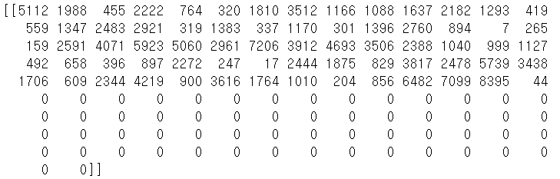
Pre-Processing
SEQ :
HMKEESEKPRGFARGLEPERIIGATDSSGELMFLMKWKNSDEADLVPAKEANVKCPQVVISFYEERLTWH

Slide 11
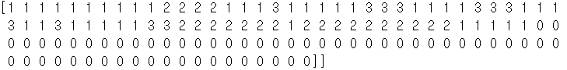
Pre-Processing
SST3 :
CCCCCCCCCCHHHHCCCECCCCCEEECCCCEEECCCECCECCCCCEEHHHHHHHCHHHHHHHHHHCCCCC
[1,0,0,0] 0
[0,1,0,0] 1
[0,0,1,0] 2
[0,0,0,1] 3
We are change string to number
1 = C, 2 = H, 3 = E

Slide 12
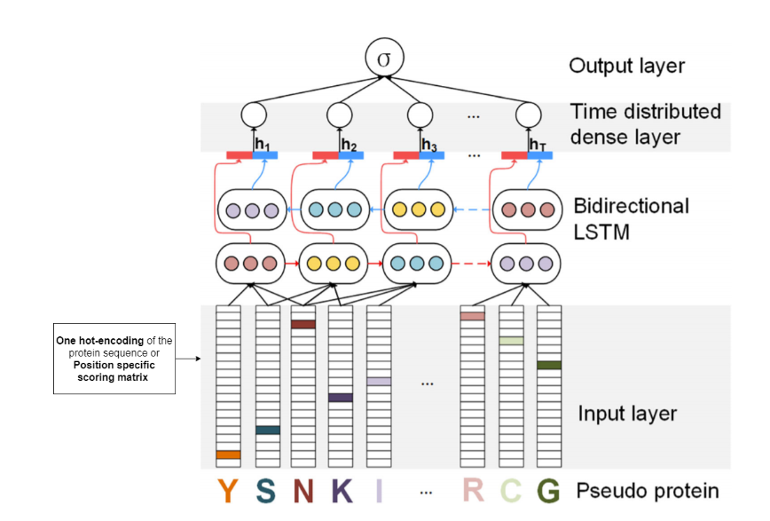
Process
0100
0100
0100
0100
5112
1988
455
7099
H
M
K
E
E
T
W
H
Reference : https://medium.com/@ankita9shreya/protein-sequence-classification-c83a6cb38548

Slide 13
Model
1. Each compare Model
 | sst3_loss | sst3_acc | Time
RNN | 23 | 86 | 63
GRU | 20 | 89 | 135
B-LSTM | 18 | 93 | 230
Reference : https://wegonnamakeit.tistory.com/25

Slide 14
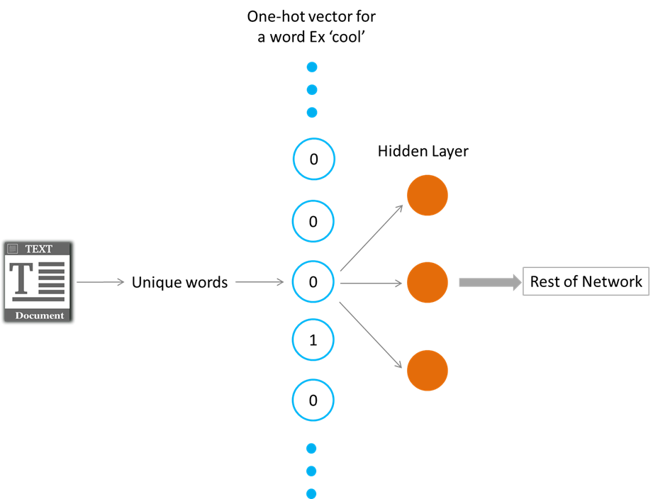
Model
2. Word Embedding
One-hot encoding
(0.3, 0.1)
HMKEESEK….LTWH
Amino acid sequence
(0.5, 0.8)
(0.2, 0.7)

Slide 15
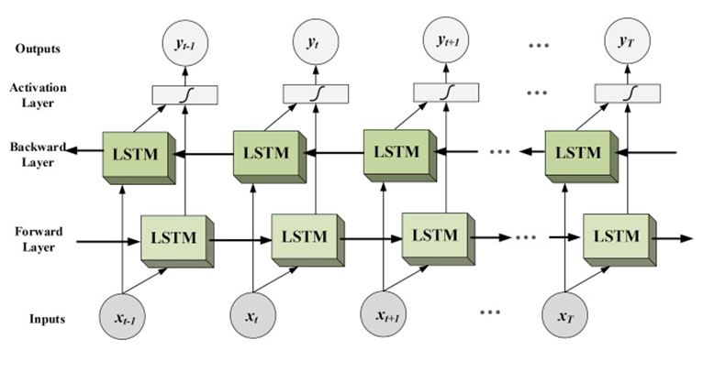
Model
3. Bidirectional LSTM
Reference :https://www.i2tutorials.com/technology/deep-dive-into-bidirectional-lstm/

Slide 16
Model
4. Bidirectional LSTM
Example
Sentence : The boy gone….
unidirectional
bidirectional
The boys gone…
… and they left the pool.

Slide 17
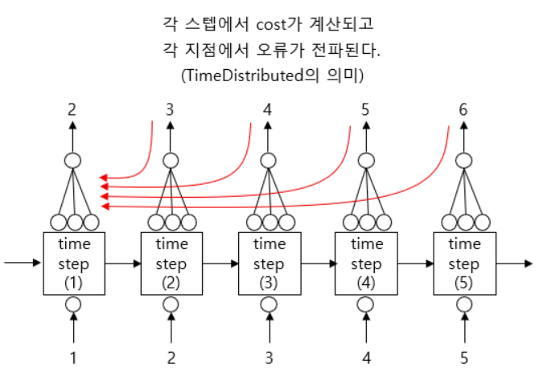
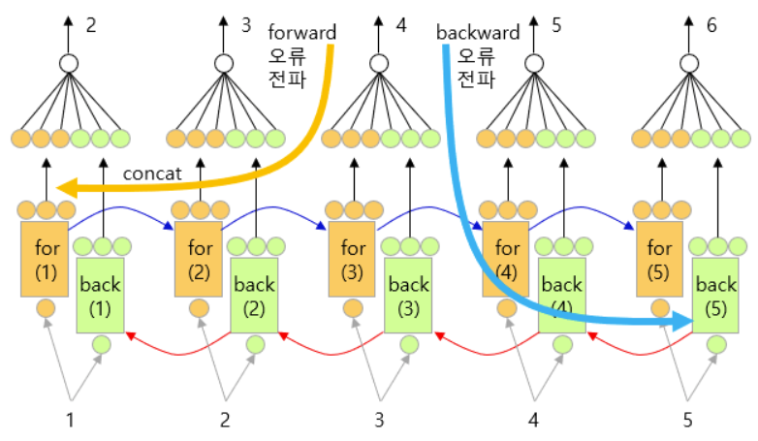
Model
5. TimeDistributed Dense
The meaning of TimeDistributed
The cost is calculated at each step and errors are propagated at each point.
Reference : https://blog.naver.com/chunjein/221589656211
Reference : https://m.blog.naver.com/PostView.nhn?blogId=chunjein&logNo=221589624838&proxyReferer=https%3A%2F%2Fwww.google.com%2F

Slide 18
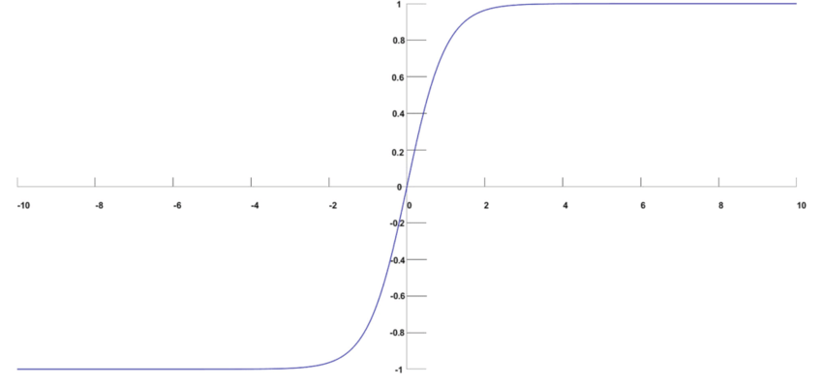
Model
6. Activation Function
Reference : https://www.researchgate.net/figure/Softmax-function-image_fig1_325856086

Slide 19
Hyper Parameter
Function (type) | input_dim | output_dim | input_length
Embedding | 8421 | 4 | 128
Layer (type) | units | return_sequence | recurrent_dropout
Bidirectional(LSTM) | 64 | True | 0.1
Layer (type) | output_dim | input_dim | activation
TimeDistributed(Dense) | 4 | 4 | softmax
Function (type) | optimizer | loss
complie | rmsprop | categorical_crossentropy
Function (type) | batch_size | epochs | verbose
fit | 128 | 20 | 1
Reference : https://keras.io/

Slide 20
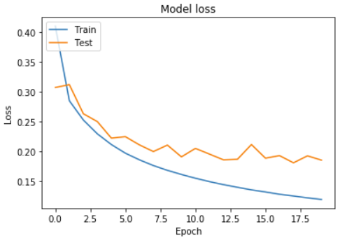
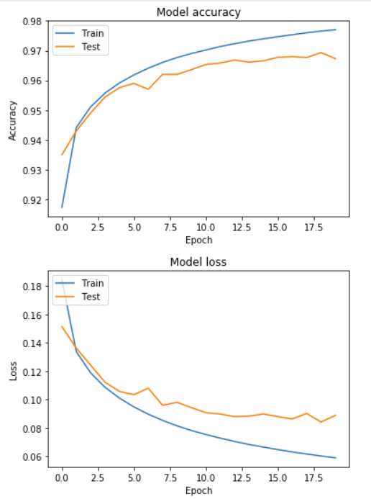
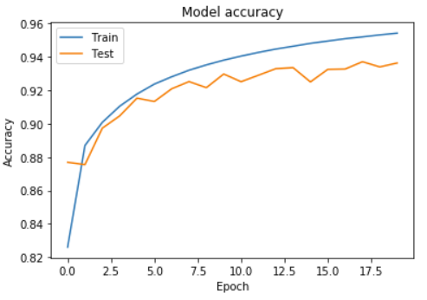
Conclusion
Before
After

Slide 21
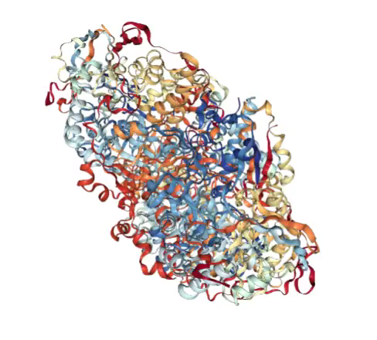
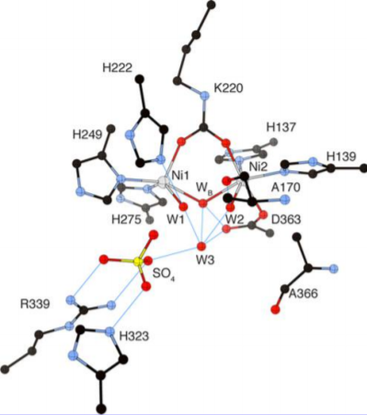
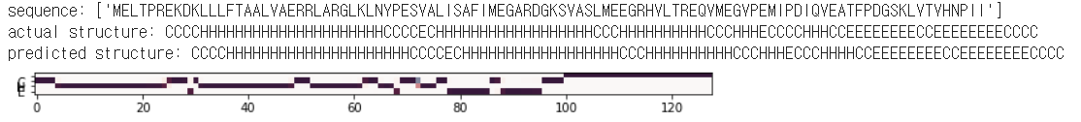
Conclusion
PDB_ID : 1A5K
Structure H : 55
Structure E : 18

Slide 22
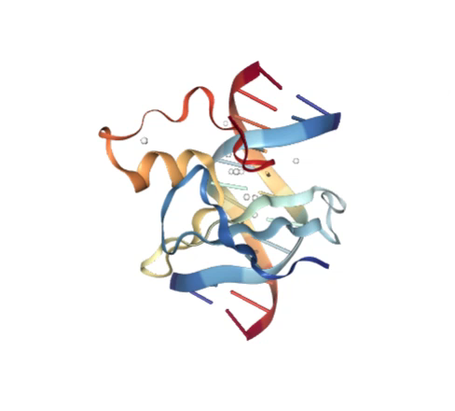
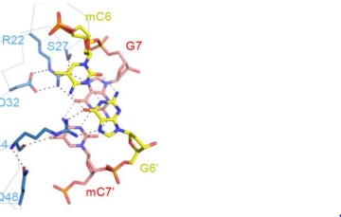
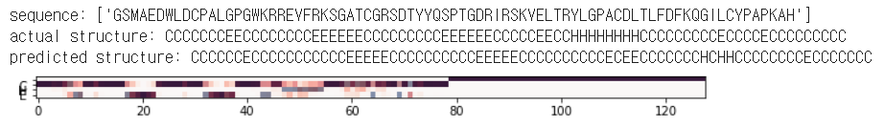
Conclusion
PDB_ID : 6D1T
Structure H : 3
Structure E : 15

Slide 23

Q & A

Slide 24
Q & A
THANK YOU

